Slide 1
TCP/IP Protocols in Smart Agriculture IoT systems.
Tiprigan ionut Tiberiu
Ciobotariu Andrei

Slide 2
Content
Introduction
Overview of TCP/IP Protocols
Applications of TCP/IP in Smart Agriculture
Benefits and impacts
Case Studies and Success Stories
Challenges and Future Directions
Conclusion + Q&A Session

Slide 3
introduction
The convergence of technology and farming practices is taking place nowadays, and we aim to explore a fundamental aspect of this digital revolution: TCP/IP protocols in Smart Agriculture IoT systems.
Why are TCP/IP protocols used in IoT systems?
The significance of IoT in transforming agricultural practices
Why TCP/IP as the communication infrastructure? The role of TCP/IP

Slide 4
Why are TCP/IP protocols used in IoT systems?
Ubiquity and Compatibility
Reliable Data transmission
Connection-oriented Communication
Support for IP-based Networks
Scalability and Flexibility
Integration with Existing Infrastructure
TCP/IP protocols offer a robust, reliable and standardized communication framework that aligns well with the requirements of IoT systems

Slide 5
The significance of IoT in transforming agricultural practices :
Collection and analysis of real-time data from various sources.
Monitoring and managing crucial parameters (soil moisture, temperature, humidity , etc).
IoT devices (sensors, actuators, etc) that facilitate precise and automated control over irrigation systems, fertilizer application and pest management, thus reducing waste and optimizing crop yields.
Connected agricultural machinery equipped with IoT technology enable predictive maintenance, improved operational efficiency and minimizing downtime.
Livestock monitoring systems which can track the health and behaviour of animals.
Integrating IoT with data analytics and machine learning, farmers can gain valuable insight into crop conditions, market trends and weather patterns

Slide 6
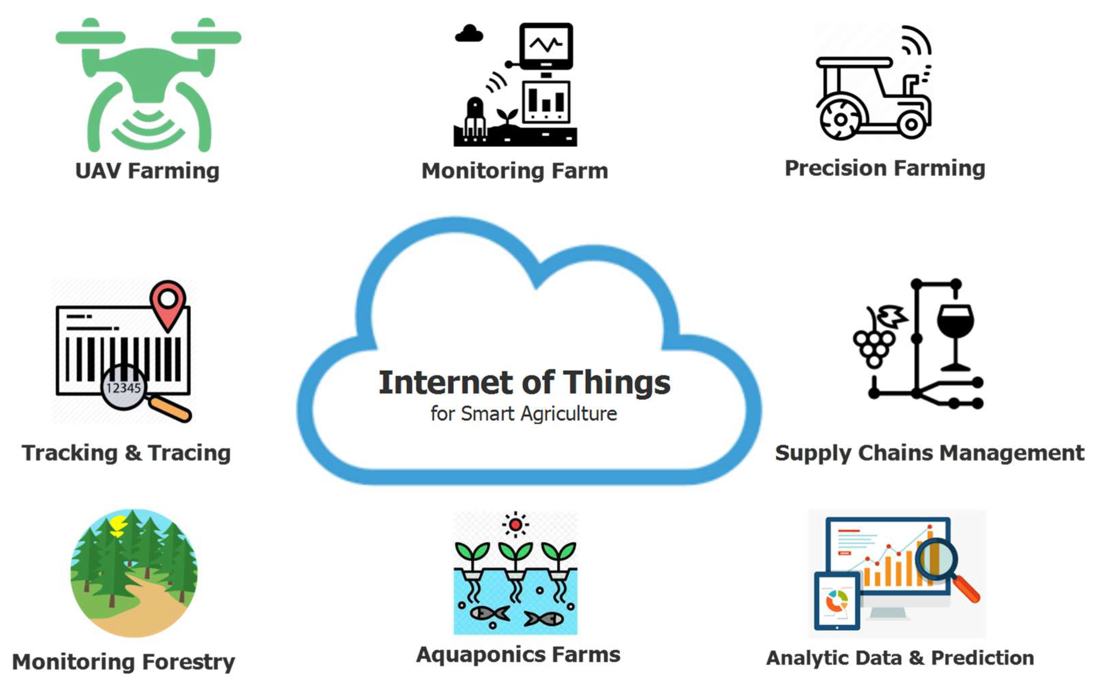

Slide 7
Why TCP/IP as the communication infrastructure? The role of TCP/IP
Standardization
Internet Connectivity
Reliable Data Transmission
Connection-oriented Communication
Security Capabilities
Exisiting Infrastructure
Scalability and Flexibility

Slide 8
Overview of TCP/IP protocols
What are TCP/IP protocols?
Transmission Control Protocol(TCP)
Internet Protocol (IP)
Together, TCP/IP provides a standardized and reliable communication framework for devices to connect, exchange data, and communicate over networks.
TCP handles the reliable delivery of data
IP handles addressing and routing
Seamless and robust data transmission

Slide 9
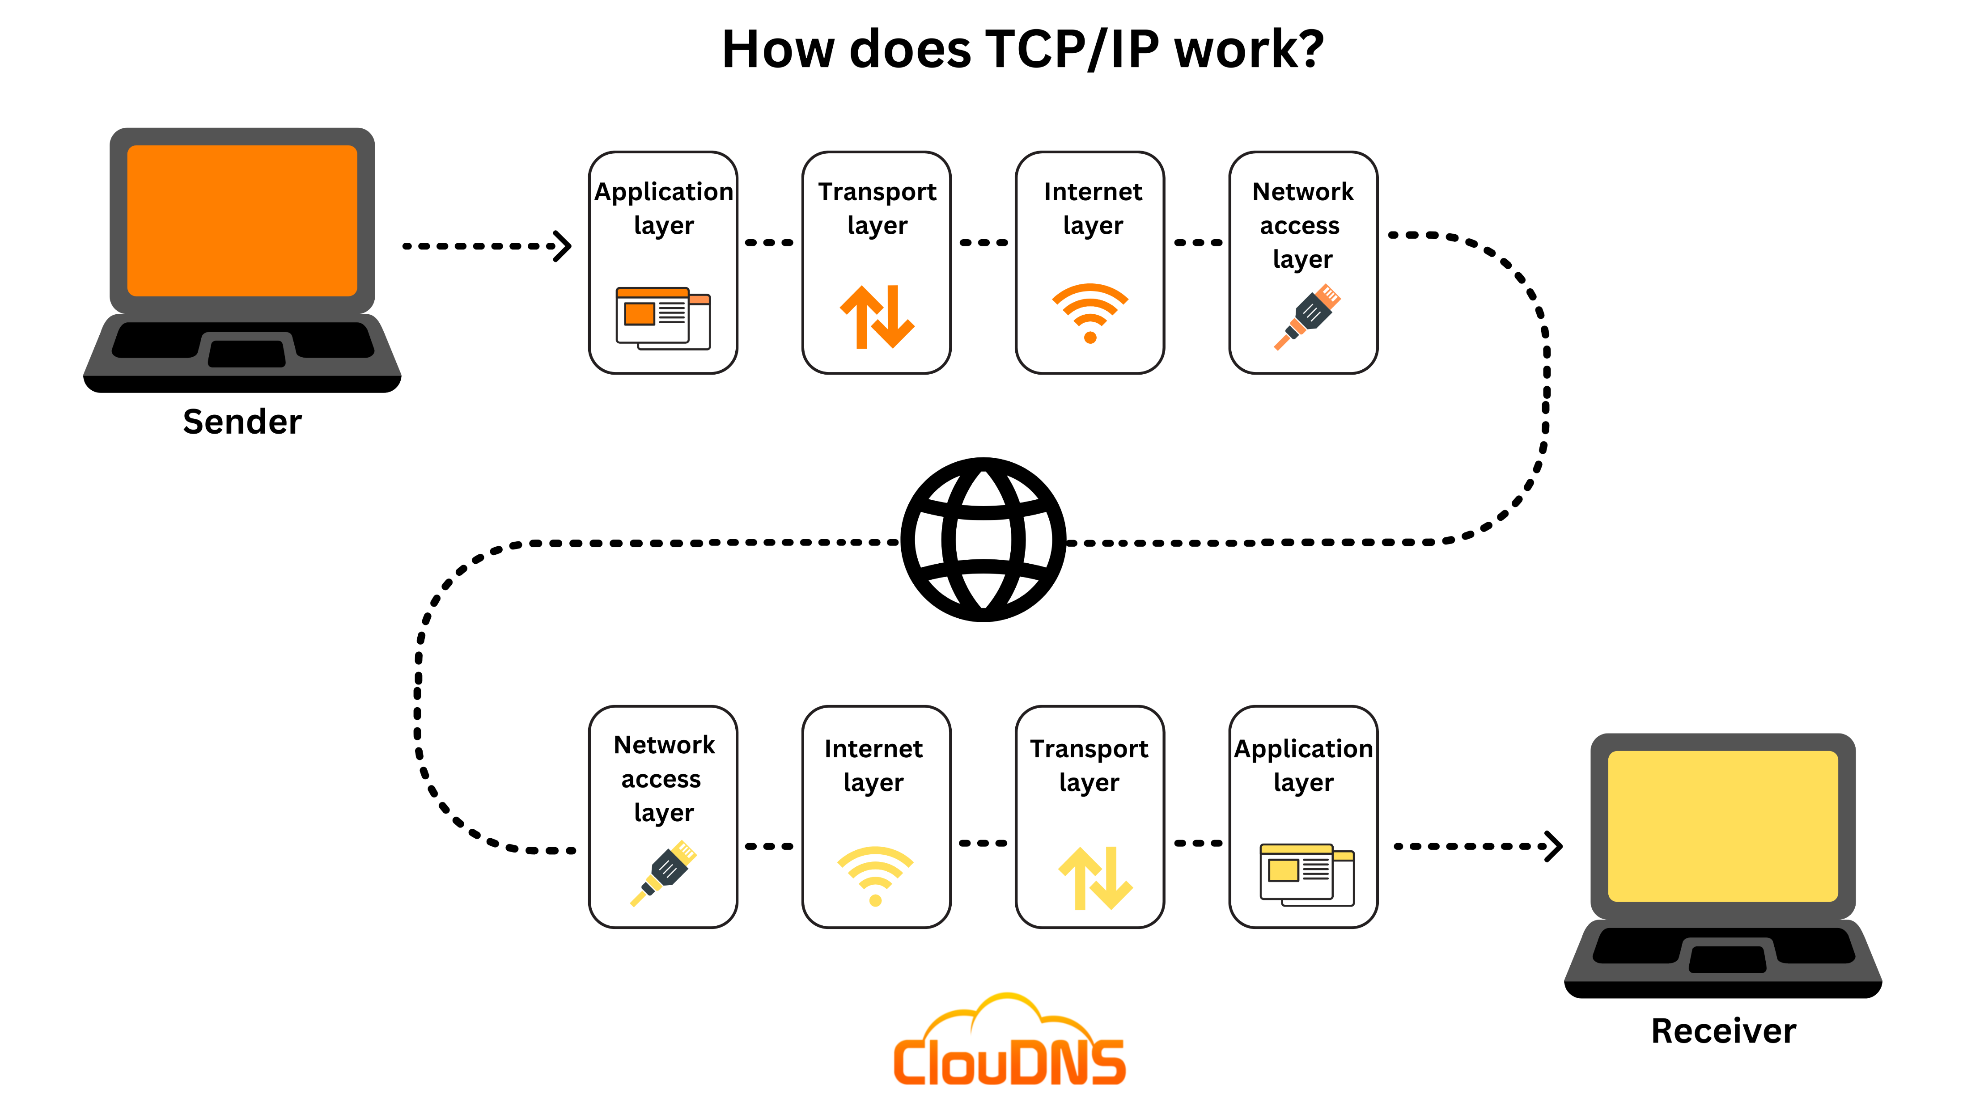

Slide 10
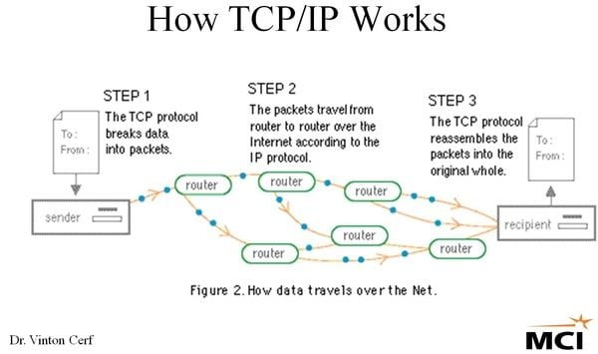

Slide 11
Brief History of TCP/IP protocols
The development of TCP/IP protocols traces back to the late 1960s and early 1970s, coinciding with the creation of the ARPANET (Advanced Research Projects Agency Network), the precursor to the modern internet. The history goes as follows:
ARPANET and NCP(late 1960s)
TCP/IP (1970s): Vinton Cerf and Bob Kahn developed TCP, focusing on reliable data transmission. Then came IP, designed by Bob Kahn and later refined by Jon Postel , for routing and addressing
1983: TCP/IP was adopted as primary networking protocol for ARPANET, replacing NCP. In the same year, TCP/IP was declared the standard protocol for the DDN.
TCP/IP Suite

Slide 12
Internet Expansion : TCP/IP became the backbone protocol for global internetworking. The standardization and adoption of TCP/IP allowed for the seamless connection of diverse networks, leading to the modern internet as we know it today
Standardization by IETF: The internet engineering task force(IETF) played a crucial role in the standardization of TCP/IP protocols.
IPv4 to IPv6 Transition

Slide 13
Applications of tcp/ip in smart agriculture
TCP/IP protocols play a crucial role in enabling a range of applications in Smart Agriculture IoT systems.
Precision Irrigation
Smart Pest Management and Disease Detection
Livestock Monitoring
Crop Health Assesment
By leveraging TCP/IP protocols, Smart Agriculture IoT systems can revolutionize these and many other applications. TCP/IP enables reliable and timely communication which ensures that crucial data is transmitted seamlessly, thus helping farmers to optimize resources, enhance productivity , and making informed decisions

Slide 14
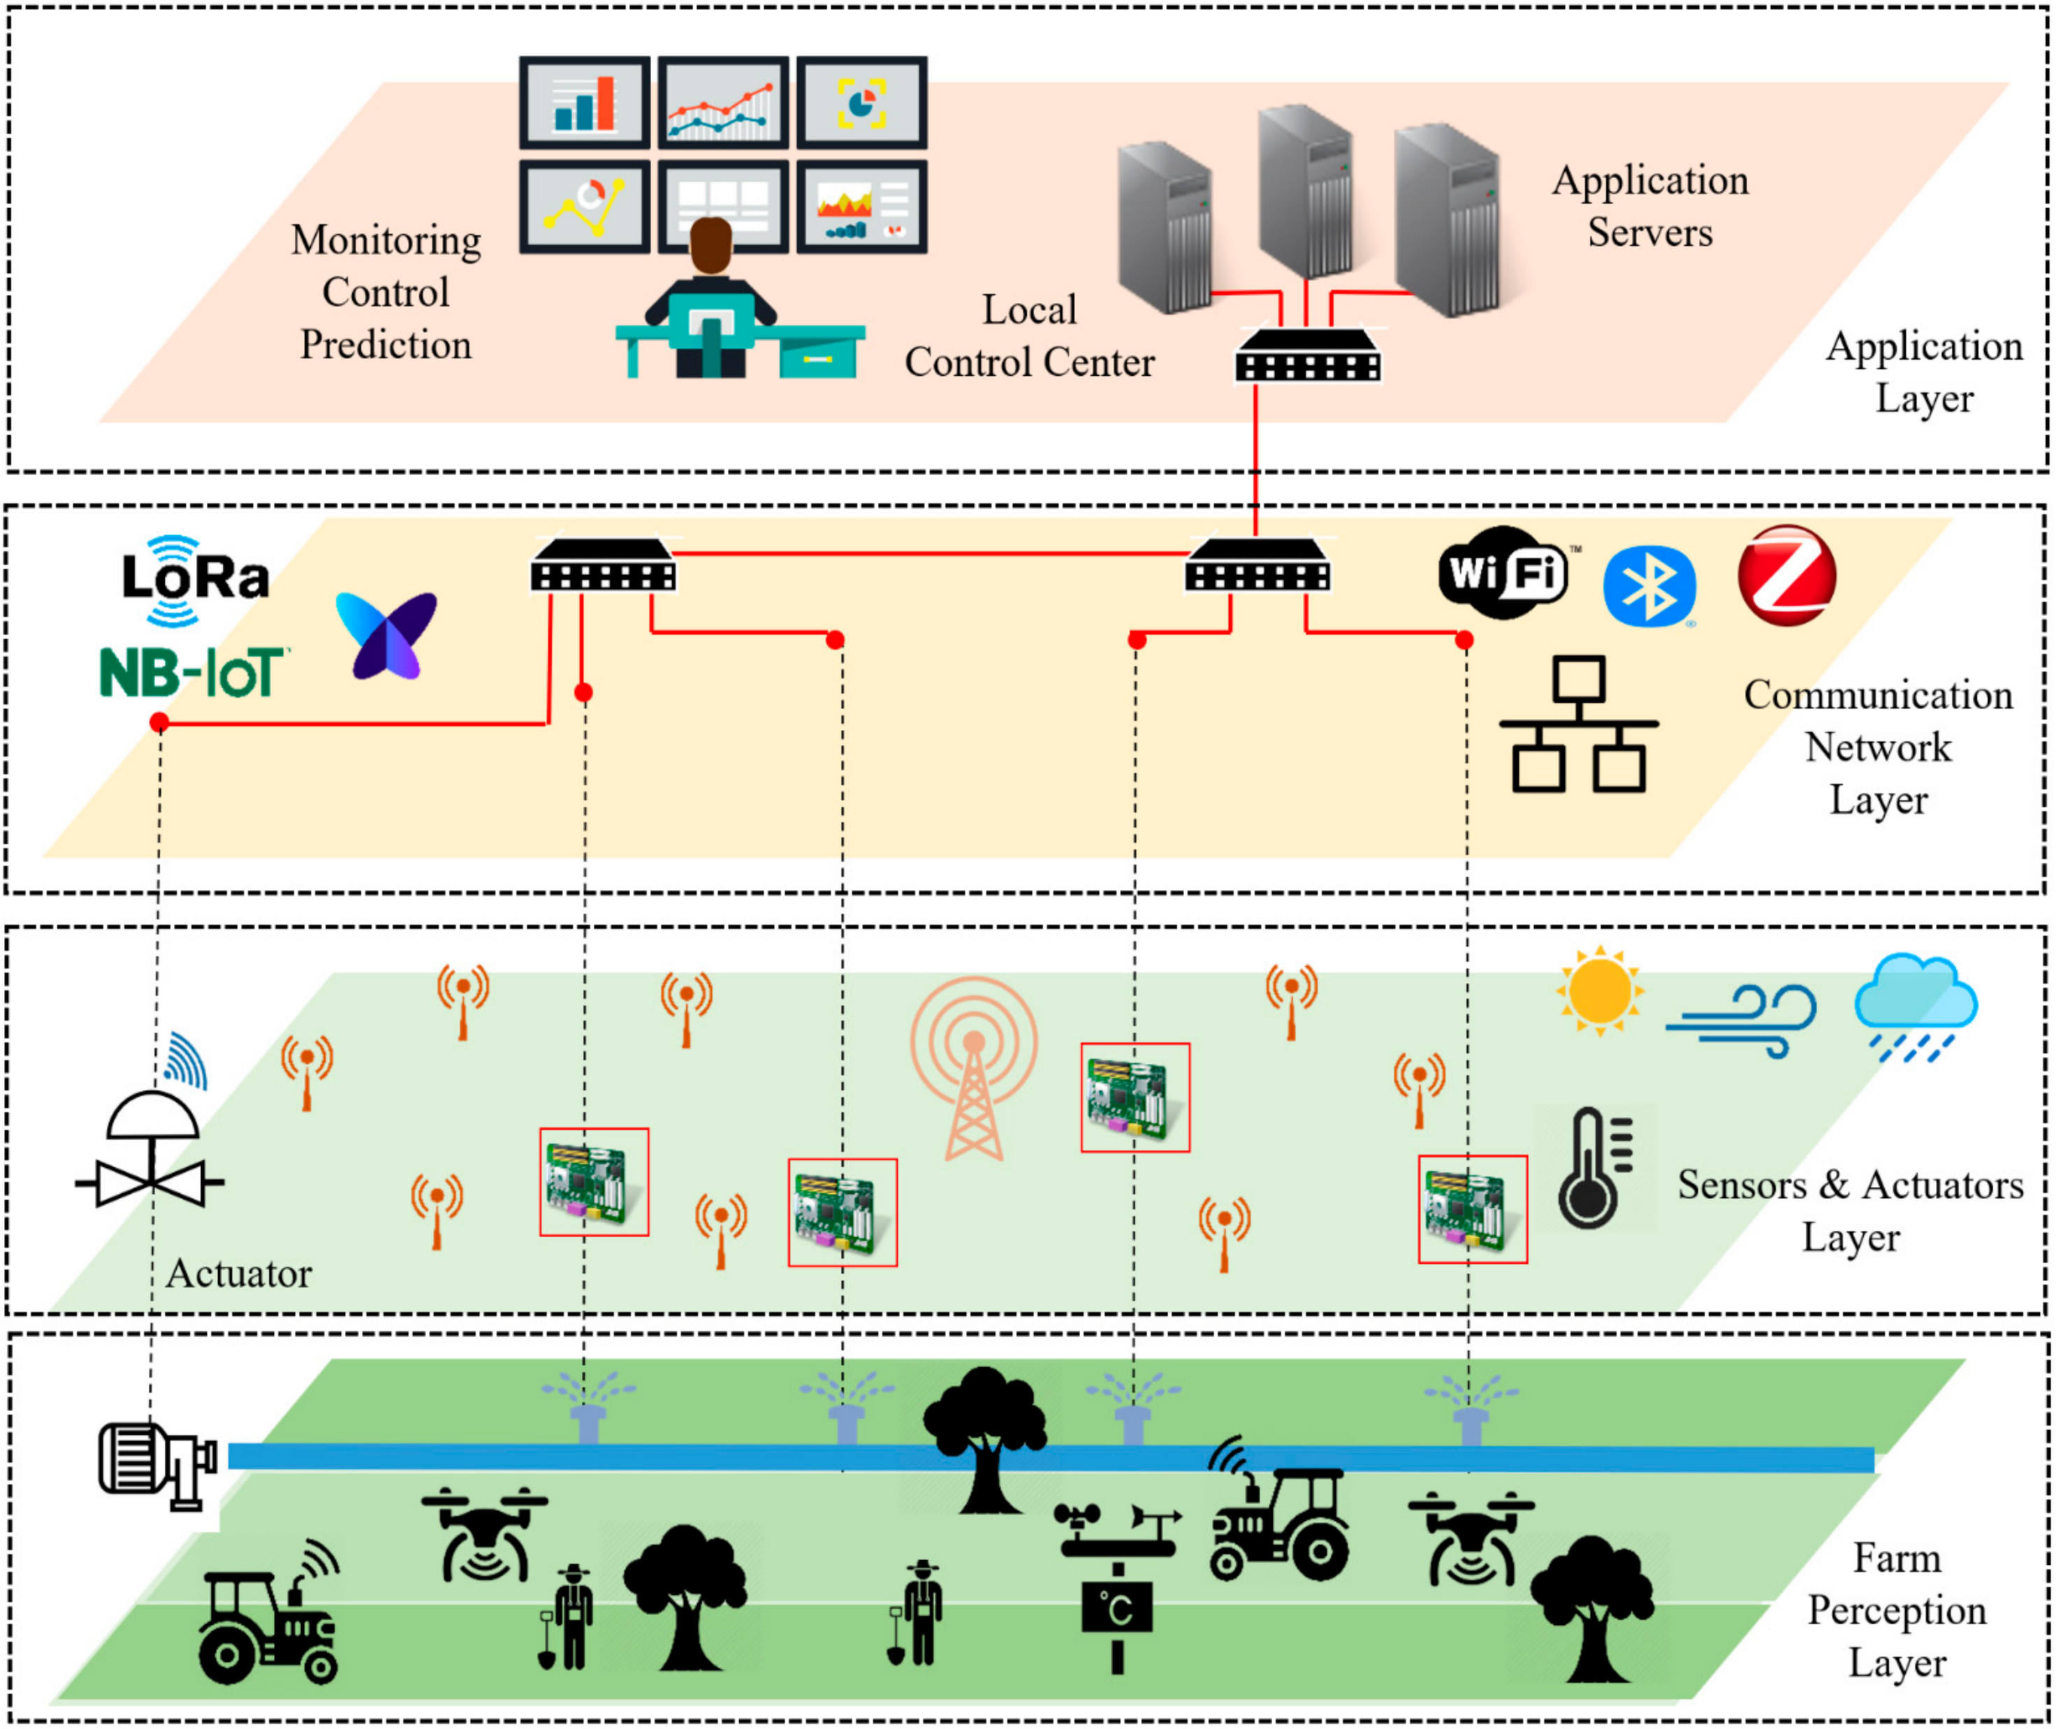

Slide 15
Benefits and Impacts of TCP/IP Protocols in Smart Agriculture
Increased Farm Efficiency and Optimized Operations
Data-Driven Decision-Making and Precision Agriculture
Resource Conservation and Sustainable Farming Practices
TCP/IP protocols enhance farm efficiency, optimize operations, and facilitate resource conservation. This integration of technology in agriculture not only increases productivity but also promotes sustainable farming practices, contributing to a more efficient and environmentally friendly agricultural sector

Slide 16
Case Studies and success stories
Case Study : The connected Vineyard ( California)
Outcomes and benefits:
Improved irrigation management
Enhanced disease detection and prevention
Increased crop yield and quality
Lesson learned :
Reliable connectivity is crucial: The success of the project relied on robust TCP/IP connectivity to ensure continuous data transmission and real-time monitoring
Integration of data analytics : The winery learned the importance of integrating data analytics into their farm management system to extract valuable insights from the data collected, enabling informed decision-making

Slide 17
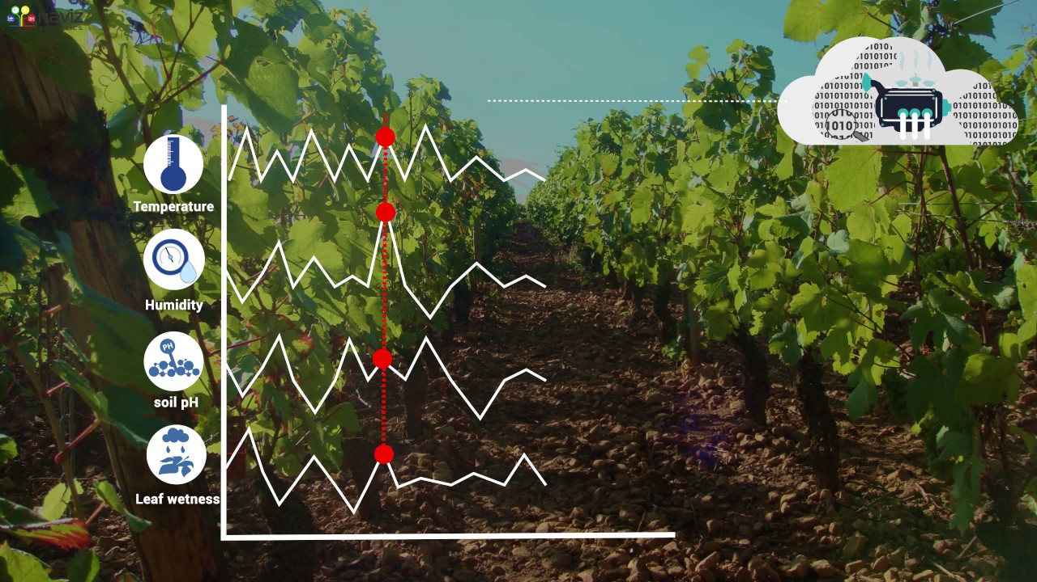

Slide 18
Case Studies and success stories
Case Study: Precision Livestock Farming (Netherlands)
Outcomes and Benefits:
Early detection of health issues
Optimized feeding and reproduction management
Enhanced animal welfare
Lessons learned:
Data security and privacy: The case study highlighted the importance of implementing robust security measures to protect sensitive animal data transmitted through TCP/IP protocols.
System scalability: As the farm expanded, the TCP/IP infrastructure needed to be scalable and capable of handling increasing data volumes

Slide 19
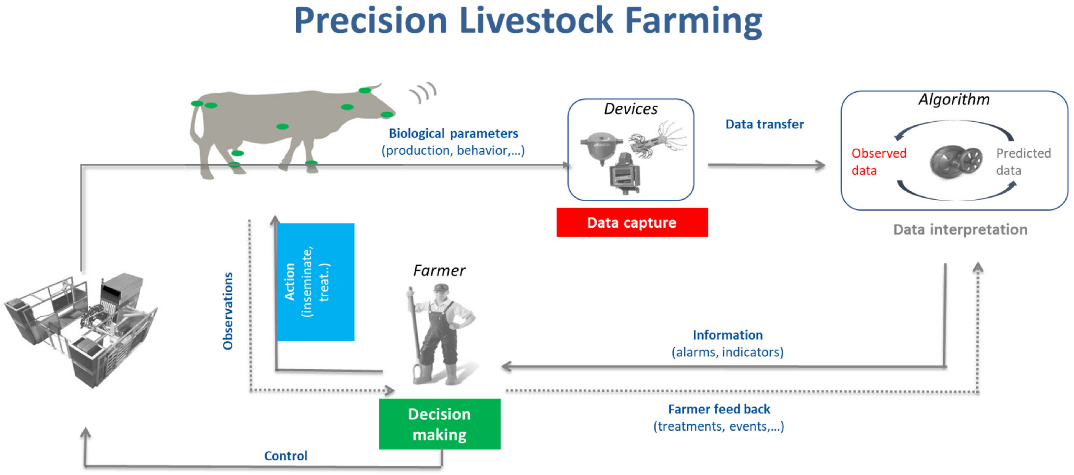

Slide 20
Case Studies and success stories
Case Study: Smart Irrigation System in a Crop Farm (Australia)
Outcomes and Benefits:
Precise irrigation scheduling
Increased crop yield
Cost savings
Lessons learned:
Customization and calibration: The farm learned the importance of calibrating the soil moisture sensors according to the specific crop types and soil conditions. Customization allowed for more accurate data collection and improved decision-making
Integration with weather data: The farm realized the value of integrating weather data into their TCP/IP-enabled system. By combining soil moisture data with weather forecasts, farmers could make more informed irrigation decisions, considering factors such as rainfall predictions and evapotranspiration rates

Slide 21
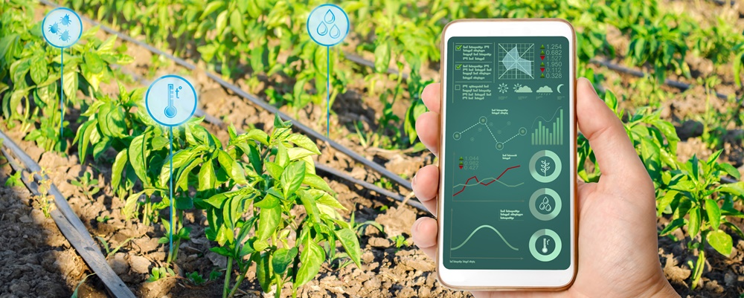

Slide 22
Challenges and Future Directions
Challenges and Limitations of Implementing TCP/IP Protocols in Smart Agriculture:
Connectivity and Network Infrastructure (Less availability of stable internet connection in rural areas)
Data Security and Privacy (Protection of sensitive information required from unauthorized access , cyberattacks or data breaches)
Interoperability and Standardization ( Achieving interoperability and seamless communication between components can be a challenge due to lack of standardized protocols and data formats.

Slide 23
Potential Solutions and Advancements
Improved Connectivity Solutions (5G?)
Enhanced Data Security Measures (Continuous advancements in encryption algorithms, authentication mechanisms, and intrusion detection systems are crucial)
Standardization Efforts (Development and adoption of industry-wide standards for data formats, protocols, and communication interfaces are vital for interoperability)

Slide 24
Emerging Trends and Future Directions for TCP/IP in Agriculture
Edge Computing:
Integration of Artificial Intelligence (AI) and Machine Learning (ML)
Expansion of IoT Applications
Therefore, while implementing TCP/IP protocols in smart agriculture brings significant benefits, challenges related to connectivity, data security, and standardization need to be addressed. Advances in connectivity solutions, data security measures, and standardization efforts are expected to overcome these challenges. The future of TCP/IP in agriculture will see the integration of edge computing, AI/ML technologies, and further expansion of IoT applications, paving the way for more advanced and efficient smart agriculture systems

Slide 25
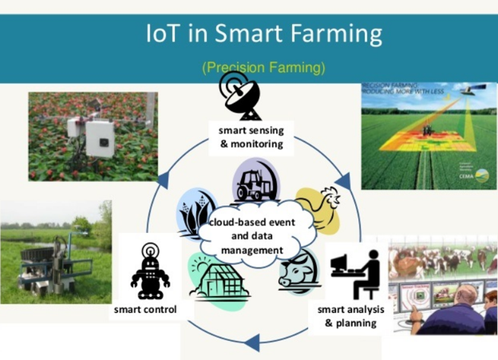

Slide 26
conclusion
TCP/IP protocols enable seamless and real-time communication between devices and systems in smart agriculture increased farm efficiency, optimized operations.
Data-driven decision-making and precision agriculture are made possible by TCP/IP protocols, allowing farmers to collect and analyze valuable data informed decision-making + precise farming practices
TCP/IP protocols facilitate resource conservation and sustainable farming practices by integrating IoT devices and sensors efficient resource utilization + conservation of water, energy, and other resources

Slide 27
Conclusion
In conclusion, TCP/IP protocols are instrumental in driving innovation in smart agriculture, offering immense potential to transform farming practices and contribute to a sustainable and efficient food production system.

Slide 28
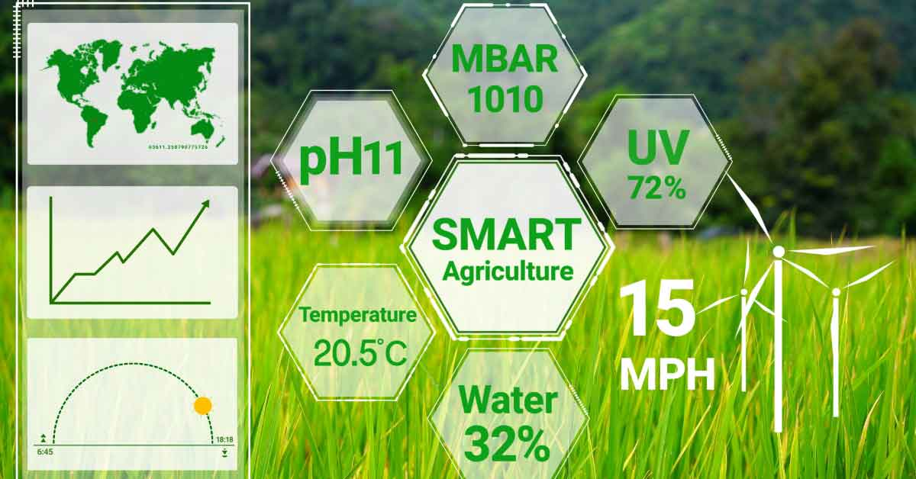

Slide 29
Q&A Session

